Slide 1
Red Black Trees

Slide 2
Red-Black Trees
A Red-Black tree is a self-balancing binary search tree in which each node contains an extra bit for denoting the color of the node, either red or black.
(0 for black, 1 for Red)

Slide 3
Self-Balancing Binary Search Trees are height-balanced binary search trees that automatically keeps height as small as possible when insertion and deletion operations are performed on tree.

Slide 4
Why Red-Black Trees?
Most of the BST operations (e.g., search, insert, delete.. etc) take O(h) time where h is the height of the BST.
The cost of these operations may become O(n) for a skewed Binary tree, where n is the number of nodes. If we make sure that height of the tree remains O(Logn) after every insertion and deletion, then we can guarantee time complexity of O(Logn) for all these operations.
The height of a Red-Black tree is always O(Logn) where n is the number of nodes in the tree.

Slide 5
Comparison with AVL Tree
AVL trees are more balanced compared to Red-Black Trees, but they may cause more rotations during insertion and deletion.
So, if our application involves many frequent insertions and deletions, then Red-Black trees should be preferred.
And if the insertions and deletions are less frequent and search is a more frequent operation, then AVL tree should be preferred over Red-Black Tree.

Slide 6
Red-Black Trees
A Red-Black tree is a self-balancing binary search tree in which each node contains an extra bit for denoting the color of the node, either red or black.
(0 for black, 1 for Red)
A Red-black tree Properties
Red/Black Property: Every node is colored, either red or black.
Root Property: The root is black.
Leaf Property: Every leaf (NIL Node) is black.
Red Property or Color Property: If a red node has children then, the children are always black nodes. (There cannot be two consecutive Red nodes on a path)
Depth Property: For each node, any simple path from this node to any of its descendant leaves has the same number of black nodes (also known as black-depth ).

Slide 7
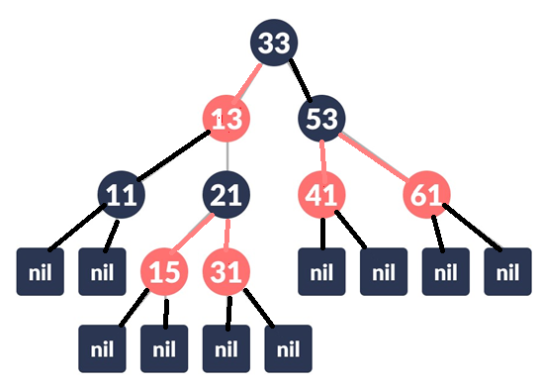
EXAMPLE OF A RED-BLACK TREE

Slide 8
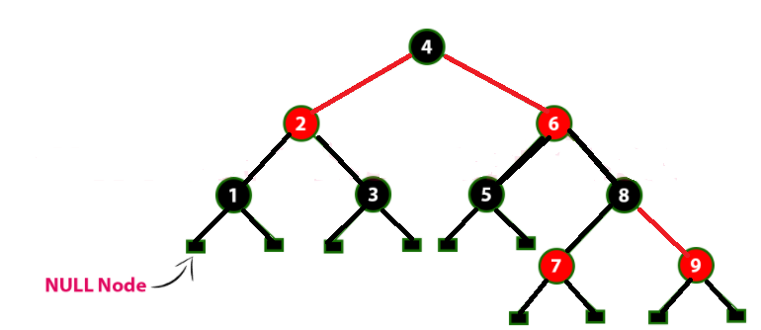
Example
Following is a Red-Black Tree which is created by inserting numbers from 1 to 9.

Slide 9
Insertion into RED BLACK Tree
The insertion operation in Red Black Tree is similar to insertion operation in Binary Search Tree. But every node is inserted with a color attached to it.
After every insertion operation, we need to check all the properties of Red-Black Tree. If all the properties are satisfied then we go to next operation otherwise we perform any of the following operations to make it Red Black Tree.
Recolor
Rotation
Rotation followed by Recolor

Slide 10
The insertion operation in Red Black tree is performed using the following steps...
Step 1 - Check whether tree is Empty.
Step 2 - If tree is Empty then insert the newNode as Root node with color
Black and exit from the operation.
Step 3 - If tree is not Empty then insert the newNode at the
appropriate position and fill with Red color
Step 4 - If the parent of newNode is Black then exit from the operation.
Step 5 - If the parent of newNode is Red then check the color of parent node's sibling of newNode.
If it is colored Red then Recolor. Repeat the same until tree becomes Red Black Tree.
If it is colored Black or NULL then make suitable Rotation and Recolor it.

Slide 11
Balancing RED-Black Trees during Insertions
The following notation is used to name the keys while defining cases of balancing
u is the newly inserted node.
p is the parent node of u.
g is the grandparent node of u.
Un is the uncle node of u. (Child of g, sibling of p)
Insertion cases can be broadly classified in to two cases:
Case a): Colour of Un node is Red. This case has 4 subcasses depending on positions of u,p, and g. No Rotations are required in this case, Only Recoloring has to be done.
LLr, LRr, RRr, RLr
Case b): Colour of Un node is Black or there is no Un node. This case has 4 subcasses depending on positions of u,p, and g. Rotations are first done and then, recoloring has to be done if necessary.
LL, LR, RR, RL

Slide 12
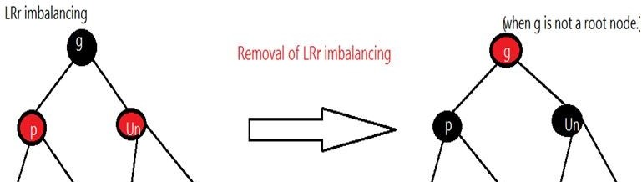
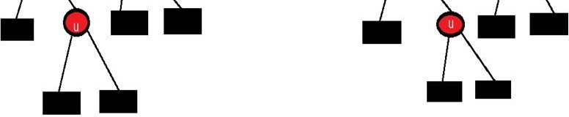
1) LRr imbalance : In this Red Black Tree violates its property in such a manner that p and u have red color at left and right positions with respect to grandparent g respectively. Therefore it is termed as Left Right imbalance. r in the case name represents red color for node Un.
Removal of LRr imbalance can be done by:
Change color of p from red to black.
Change color of Un from red to black.
Change color of g from black to red, provided g is not a root node. But then, recheck for continuous red colored nodes up
the tree till its root node.
Note: If given g is root node then there will be no changes in color of g.

Slide 13
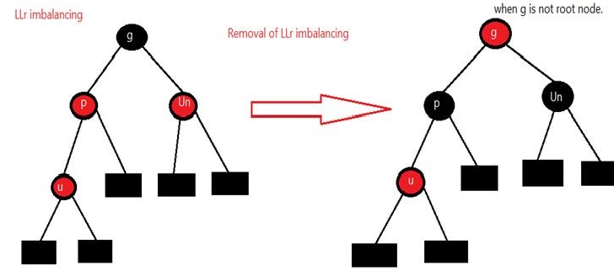
2) LLr imbalance : In this Red Black Tree violates its property in such a manner that p and u have red color at left and left positions with respect to grandparent g respectively. Therefore it is termed as Left Left imbalance.
Removal of LLr imbalance can be done by:
i.Change color of p from red to black. ii.Change color of Un from red to black.
iii.Change color of g from black to red, provided g is not a root node. But then, recheck for continuous red colored nodes up the tree till its root node.
Note: If given g is root node then there will be no changes in color of g.

Slide 14
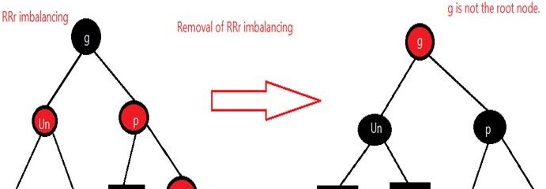
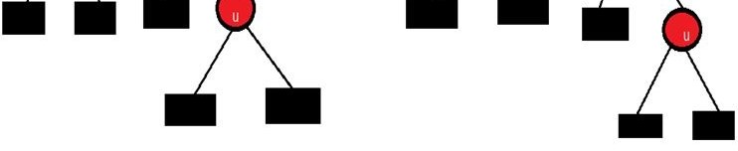

3) RRr imbalance : In this Red Black Tree violates its property in such a manner that p and u have red color at right and right positions with respect to grandparent g respectively. Therefore it is termed as Right Right imbalance.
Removal of RRr imbalance can be done by:
Change color of p from red to black. Change color of Un from red to black.
Change color of g from black to red, provided g is not a root node. But then, recheck for continuous red colored nodes up the tree till its root node.
Note: If given g is root node then there will be no changes in color of g.

Slide 15
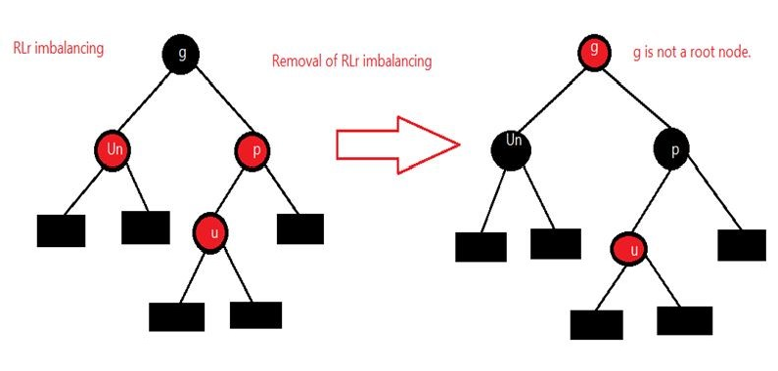
4) RLr imbalance : In this Red Black Tree violates its property in such a manner that p and u have red color at right and left positions with respect to grandparent g respectively. Therefore it is termed as Right Left imbalance.
Removal of RLr imbalance can be done by:
Change color of p from red to black. Change color of Un from red to black.
Change color of g from black to red, provided g is not a root node. But then, recheck for continuous red colored nodes up the tree till its root node.
Note: If given g is root node then there will be no changes in color of g.

Slide 16
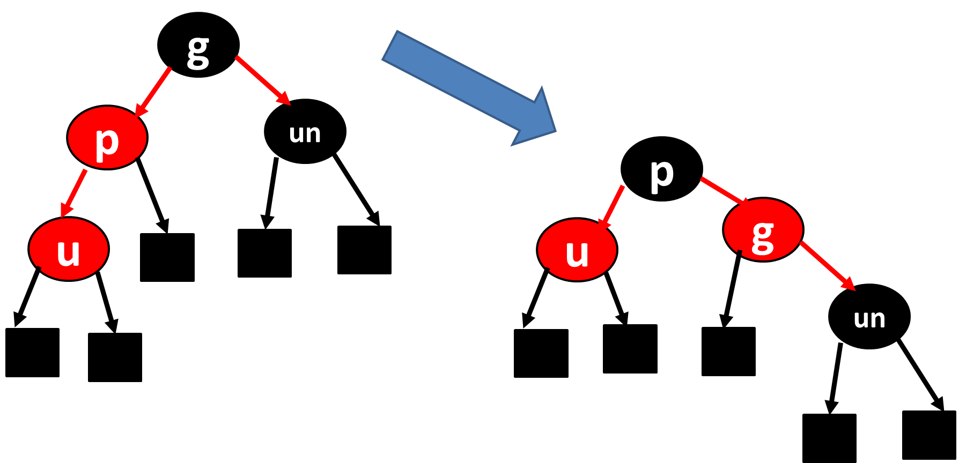
In the remaining four cases, color of node Un is black or Un is not present.
5) LL imbalance: It can be balanced by following two steps:
Apply single rotation of p around g. (LL Rotation of AVL Tree)
Recolor p to black and g to red.
u is the newly inserted node.
p is the parent node of u.
g is the grandparent node of u.
Un is the uncle node of u.
(Child of g, sibling of p)

Slide 17
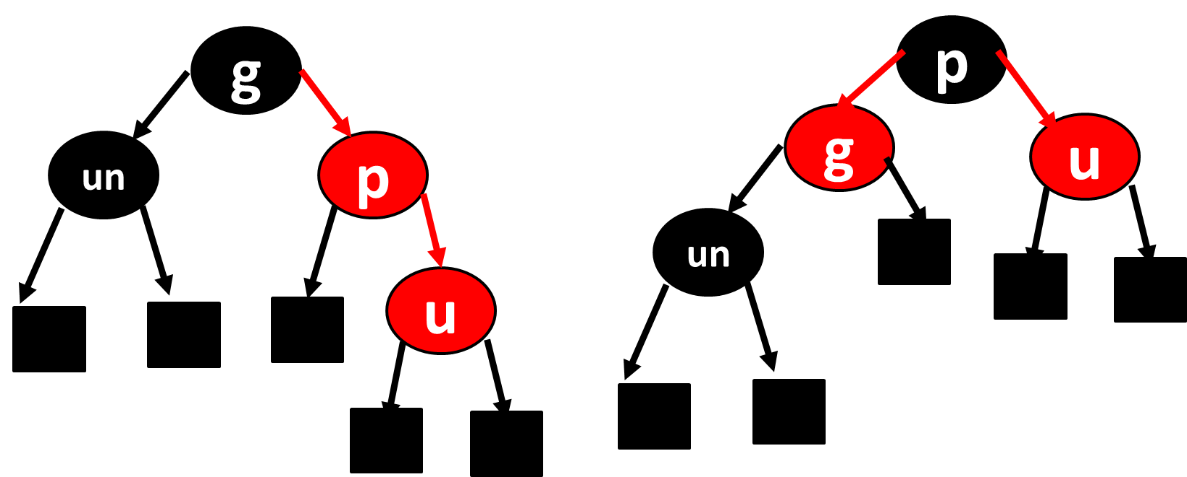
6) RR imbalance: It can be balanced by following two steps:
Apply single rotation of p around g. (RR Rotation of AVL Tree)
Recolor p to black and g to red.

Slide 18
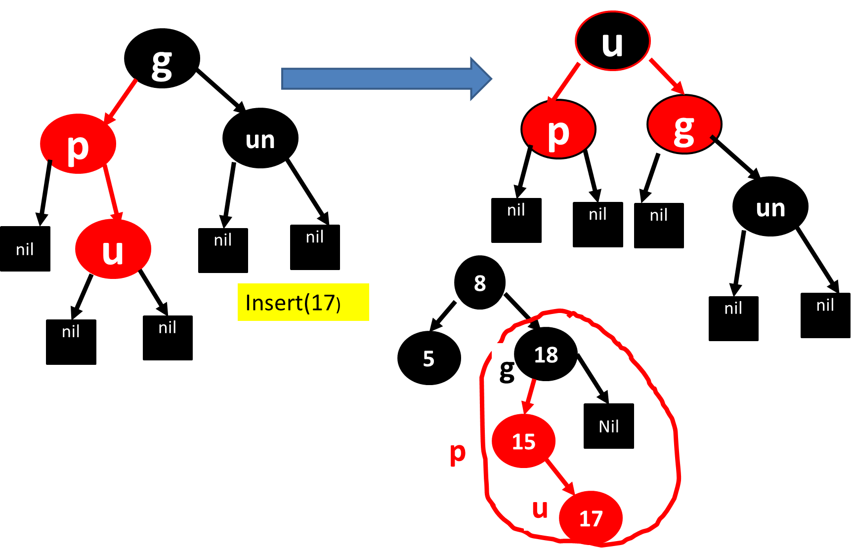
7) LR imbalance can be balanced by following steps:
Apply double rotation of u around p followed by u around g. (LR Rotation of AVL Tree)
Recolor u to black and g to red.

Slide 19
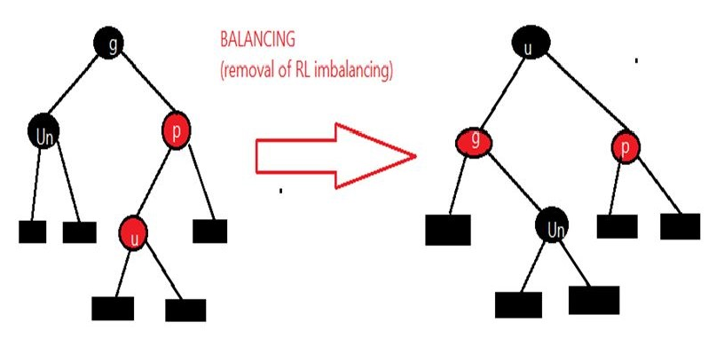
8) RL imbalance can be balanced by following steps:
Apply double rotation of u around p followed by u around g. (RL Rotation of AVL Tree)
Recolor u to black and g to red.

Slide 20
Insert into Red-Black 8,18,5,15,17,25,40,80
Insert(8)
Insert(18)
Insert(5)
8
8
8
Insert(15)
18
5
18
8
Recolour parent and parents sibling
8
5
18
5
18
15
15

Slide 21
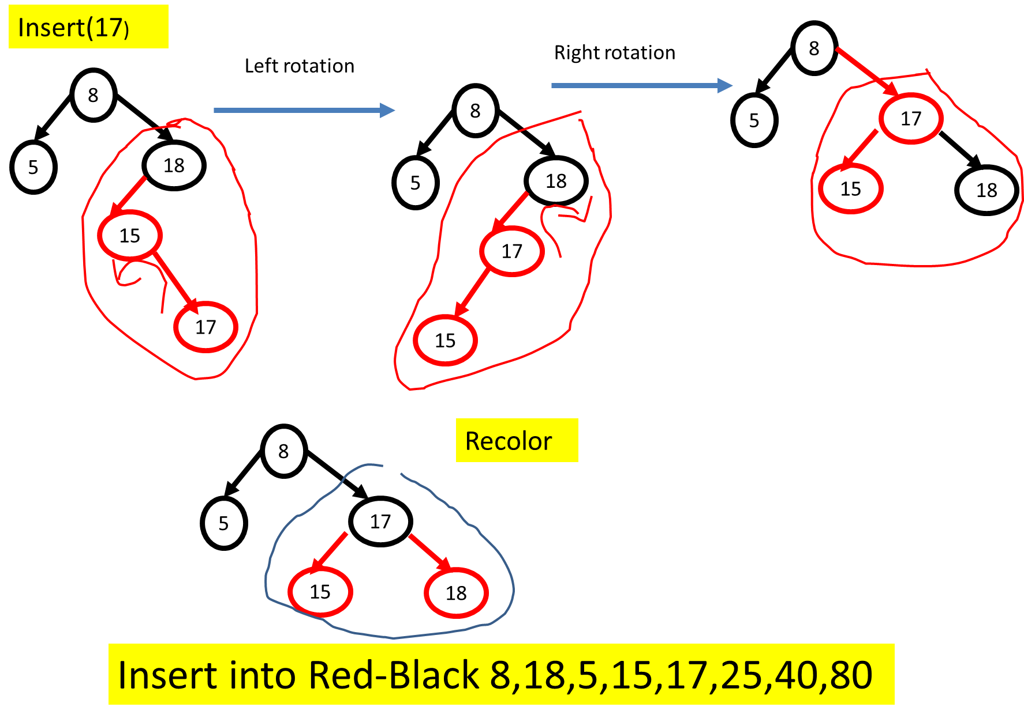

Slide 22
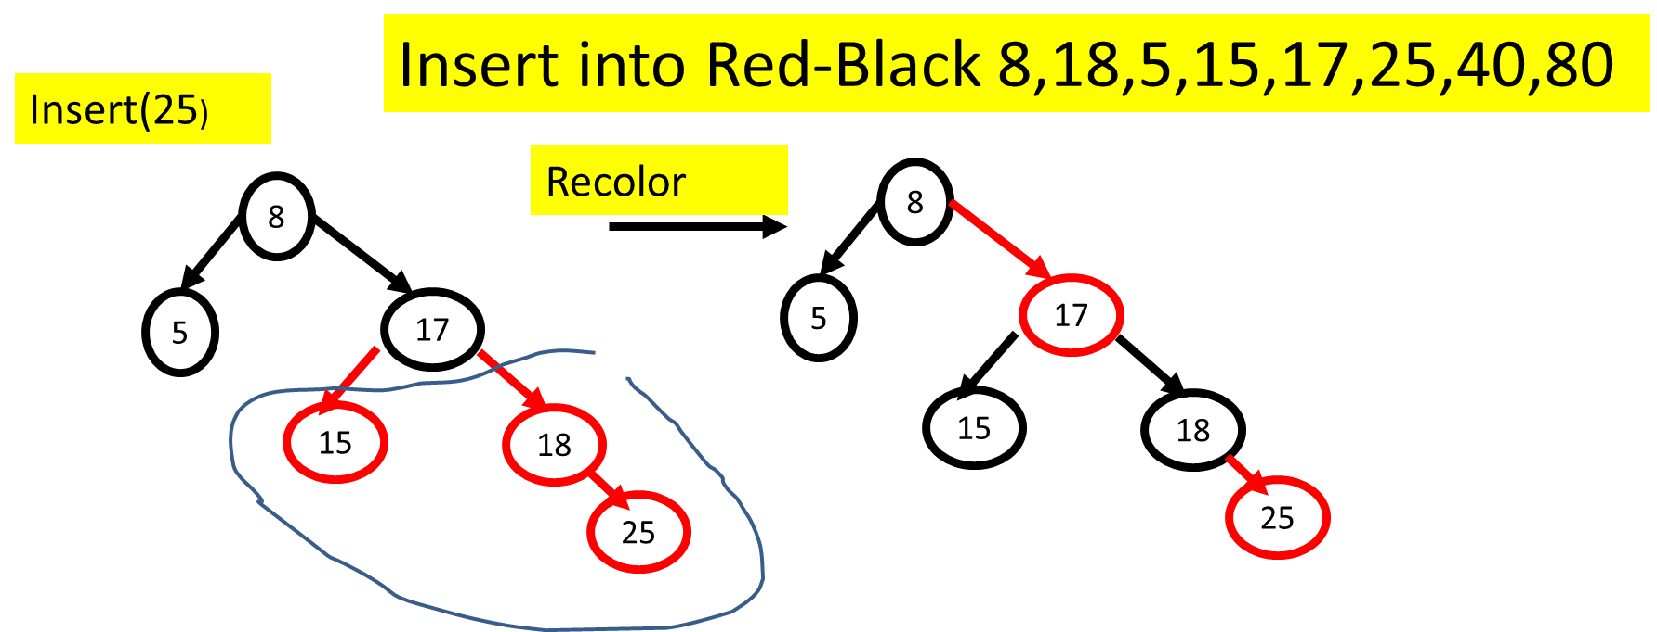

Slide 23
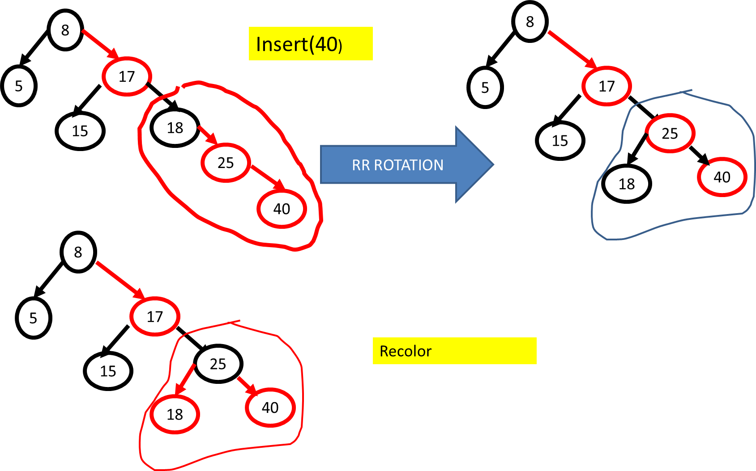
Insert into Red-Black 8,18,5,15,17,25,40,80

Slide 24
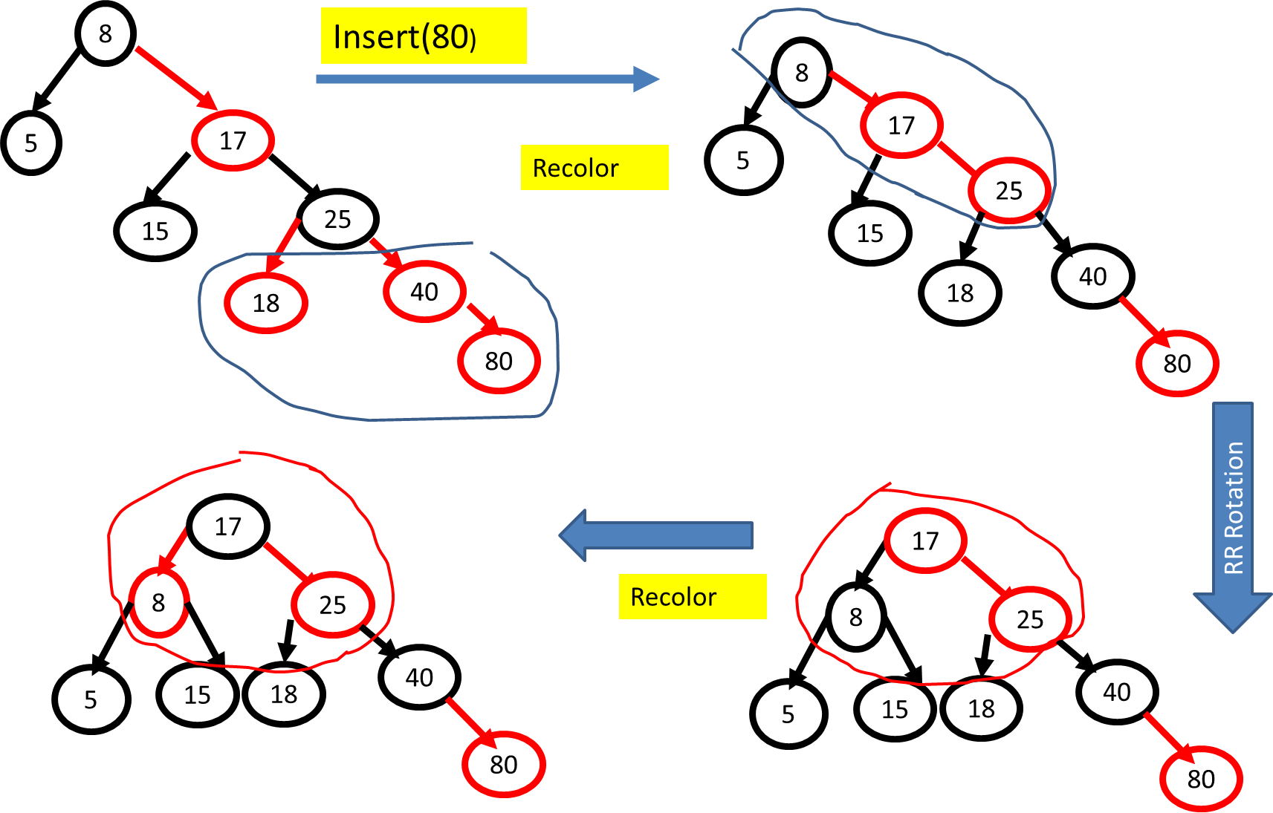

Slide 25
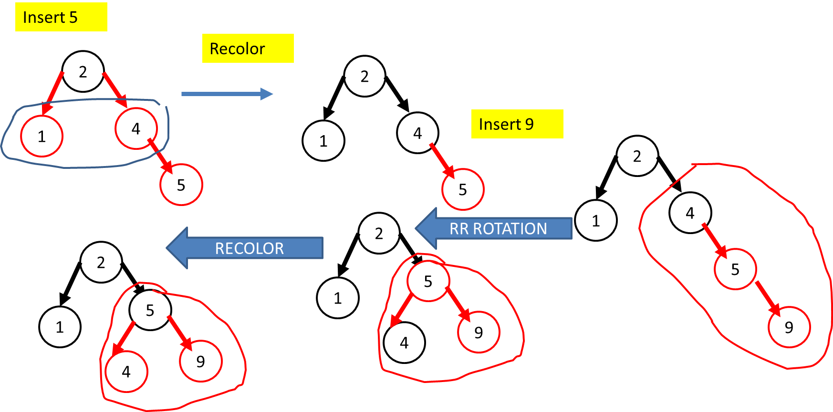
Insert 2, 1, 4, 5, 9, 3, 6, 7

Slide 26
Insert 3
Insert 6
2
2
2
RECOLOR
5
5
5
1
1
1
9
4
4
9
4
9
3
3
6
3
Insert 7
LR ROTATION
2
2
2
5
RECOLOR
5
5
1
1
1
7
7
4
9
4
4
9
3
6
9
3
6
3
6
7

Slide 27
Construct Red-Black Binary Search Tree for the following elements:20, 10, 5, 30, 40, 57, 3, 2,4, 35, 25, 18 ,22 ,21
Insert(20)
Insert(10,5)
20
20
LL Rotation
10
Recolor
10
10
20
5
20
5
5
Insert(30)
10
Recolor
10
5
20
20
5
30
30

Slide 28
Insert(40)
Recolor
RR Rotation
10
10
10
5
20
5
30
5
30
30
20
40
40
20
40
Construct Red-Black Binary Search Tree for the following elements:20, 10, 5, 30, 40, 57, 3, 2,4, 35, 25, 18 ,22 ,21
10
Recolor
Insert(57)
10
Insert(57)
5
30
5
30
20
40
20
40
57
57

Slide 29
Construct Red-Black Binary Search Tree for the following elements:20, 10, 5, 30, 40, 57, 3, 2,4, 35, 25, 18 ,22 ,21
Insert(3)
10
10
5
30
3
30
3
20
2
5
20
40
40
57
57
Insert(2)
Recolor
LL Rotation
10
10
5
30
3
30
3
2
5
20
20
40
40
57
57
2

Slide 30
Construct Red-Black Binary Search Tree for the following elements:20, 10, 5, 30, 40, 57, 3, 2,4, 35, 25, 18 ,22 ,21
10
3
30
2
5
20
40
57
Insert(4)
Recolor
10
10
3
30
3
30
2
5
20
2
40
5
20
40
57
57
4
4

Slide 31
Construct Red-Black Binary Search Tree for the following elements:20, 10, 5, 30, 40, 57, 3, 2,4, 35, 25, 18 ,22 ,21
Insert(35)
10
3
30
2
5
20
40
4
35
57
Insert(25)
Insert(18)
10
10
3
30
3
30
2
5
20
2
20
40
5
40
25
35
57
57
4
4
18
25
35

Slide 32
Construct Red-Black Binary Search Tree for the following elements:20, 10, 5, 30, 40, 57, 3, 2,4, 35, 25, 18 ,22 ,21
10
Insert(22)
Recolor
10
3
30
30
2
5
20
3
40
2
18
35
57
5
20
40
4
25
10
4
18
25
35
57
22
30
3
22
Recolor
2
20
40
5
18
25
35
57
4
22

Slide 33
Construct Red-Black Binary Search Tree for the following elements:20, 10, 5, 30, 40, 57, 3, 2,4, 35, 25, 18 ,22 ,21
Insert(21)
10
LL Rotation
10
30
30
3
3
2
20
40
2
20
40
5
5
18
25
57
18
22
35
57
4
35
4
10
21
22
25
30
3
21
2
20
40
Recolor
5
18
22
35
57
4
21
25

Slide 34
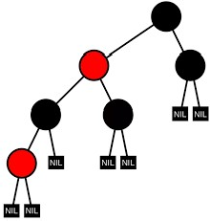
Relation between Red-Black Trees and AVL Trees
All AVL Trees are Red Black Trees. But not all Red Black Trees are AVL Trees.
An example of a Red Black Tree that is not an AVL Tree

Slide 35

Extended Binary Tree
Extended binary tree is a type of binary tree in which all the null sub tree of the original tree are replaced with special nodes called external nodes whereas other nodes are called internal nodes

Slide 36
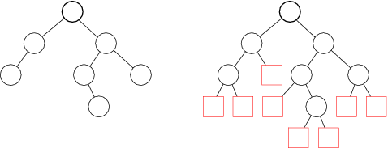
Extended Binary Tree

Slide 37
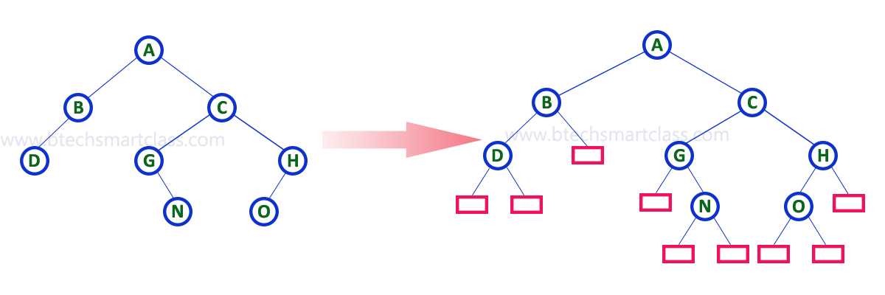
3. Extended Binary Tree

